Slide 1

Operating systems
I/O Management, System Protection and Security
Venkatesh Prasad
Department of Computer Science

Slide 2
Operating systems
System Security – The Security Problem
Venkatesh Prasad
Department of Computer Science
Notes:
To discuss security threats and attacks

Slide 3
OPERATING SYSTEMS
Slides Credits for all PPTs of this course
The slides/diagrams in this course are an adaptation, combination, and enhancement of material from the following resources and persons:
Slides of Operating System Concepts, Abraham Silberschatz, Peter Baer Galvin, Greg Gagne - 9th edition 2013 and some slides from 10th edition 2018
Some conceptual text and diagram from Operating Systems - Internals and Design Principles, William Stallings, 9th edition 2018
Some presentation transcripts from A. Frank – P. Weisberg
Some conceptual text from Operating Systems: Three Easy Pieces, Remzi Arpaci-Dusseau, Andrea Arpaci Dusseau

Slide 4
OPERATING SYSTEMS
System Security vs Protection
BASIC | SECURITY | PROTECTION
Basic | Provides the system access to legitimate users only. | Controls the access to system resources.
Handles | More complex concerns. | Quite simple queries.
Policy | Describes which person is allowed to use the system. | Specifies what files can be accessed by a particular user.
Type of threat involved | External | Internal
Mechanism | Authentication and encryption are performed. | Set or alter the authorization information.

Slide 5
OPERATING SYSTEMS
The Security Problem
System secure if resources used and accessed as intended under all circumstances
Unachievable
Intruders (crackers) attempt to breach security
Threat is potential security violation
Attack is attempt to breach security
Attack can be accidental or malicious
Easier to protect against accidental than malicious misuse

Slide 6
OPERATING SYSTEMS
Security Violation Categories
Breach of confidentiality
Unauthorized reading of data
Breach of integrity
Unauthorized modification of data/source code
Breach of availability
Unauthorized destruction of data
Theft of service
Unauthorized use of resources (ex: intruder or intrusion program may install a daemon for reading/writing files)
Denial of service (DOS)
Prevention of legitimate use

Slide 7
OPERATING SYSTEMS
Security Violation Methods
Masquerading (breach authentication)
Pretending to be an authorized user to escalate privileges
Replay attack
As is or with message modification
Man-in-the-middle attack
Intruder sits in data flow, masquerading as sender to receiver and vice versa
Session hijacking
Intercept an already-established session to bypass authentication

Slide 8
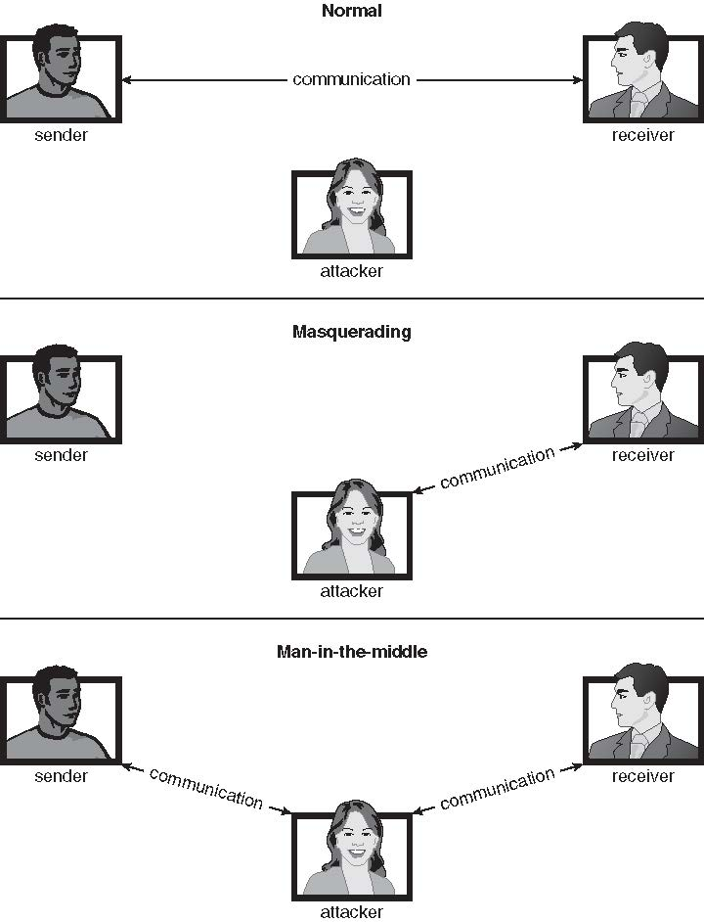
OPERATING SYSTEMS
Standard Security Attacks

Slide 9
OPERATING SYSTEMS
Security Measure Levels
Impossible to have absolute security, but make cost to perpetrator sufficiently high to deter most intruders
Security must occur at four levels to be effective:
Physical
Data centers, servers, connected terminals
Human
Avoid social engineering, phishing, dumpster diving
Operating System
Protection mechanisms, debugging
Network
Intercepted communications, interruption, DOS
Security is as weak as the weakest link in the chain
But can too much security be a problem?

Slide 10

THANK YOU
Venkatesh Prasad
Department of Computer Science Engineering
venkateshprasad@pes.edu

